Slide 1
Creating a quantum black box function to run a genetic algorithm
Ayush Hariharan

Slide 2
Intro to Quantum Computing

Slide 3
Knapsack Problem

Slide 4
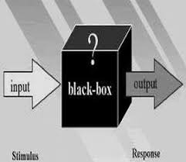
Research Question
Can I create a quantum Black-Box Function to simulate the relationship between states* before and after a disaster condition?
* A state could be any biological, numerical, or environmental system

Slide 5
Hypothesis
If I create a quantum Black-Box Function which uses a genetic algorithm, then I will accurately simulate the relationship between states before and after a disaster condition.

Slide 6
Materials
Classical Computer
5 qubit IBM Quantum Computer
Quantum Simulator
Virtual Environment to Run Python Code

Slide 7
Skills
Knowledge of Qiskit python
Comprehensive understanding of Genetic Algorithms
Knowledge of meta-stable conditions and Disaster Algorithms
Understanding of mathematical problems requiring immense computing power

Slide 8
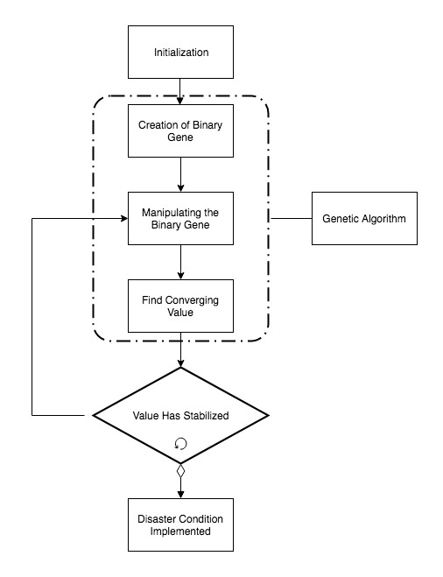
Procedure: At a Glance

Slide 9
Procedure: Initialization
Designing a black-box function that will simulate interactions between different states by manipulating 4 quantum registers, each with an encoded binary gene.

Slide 10
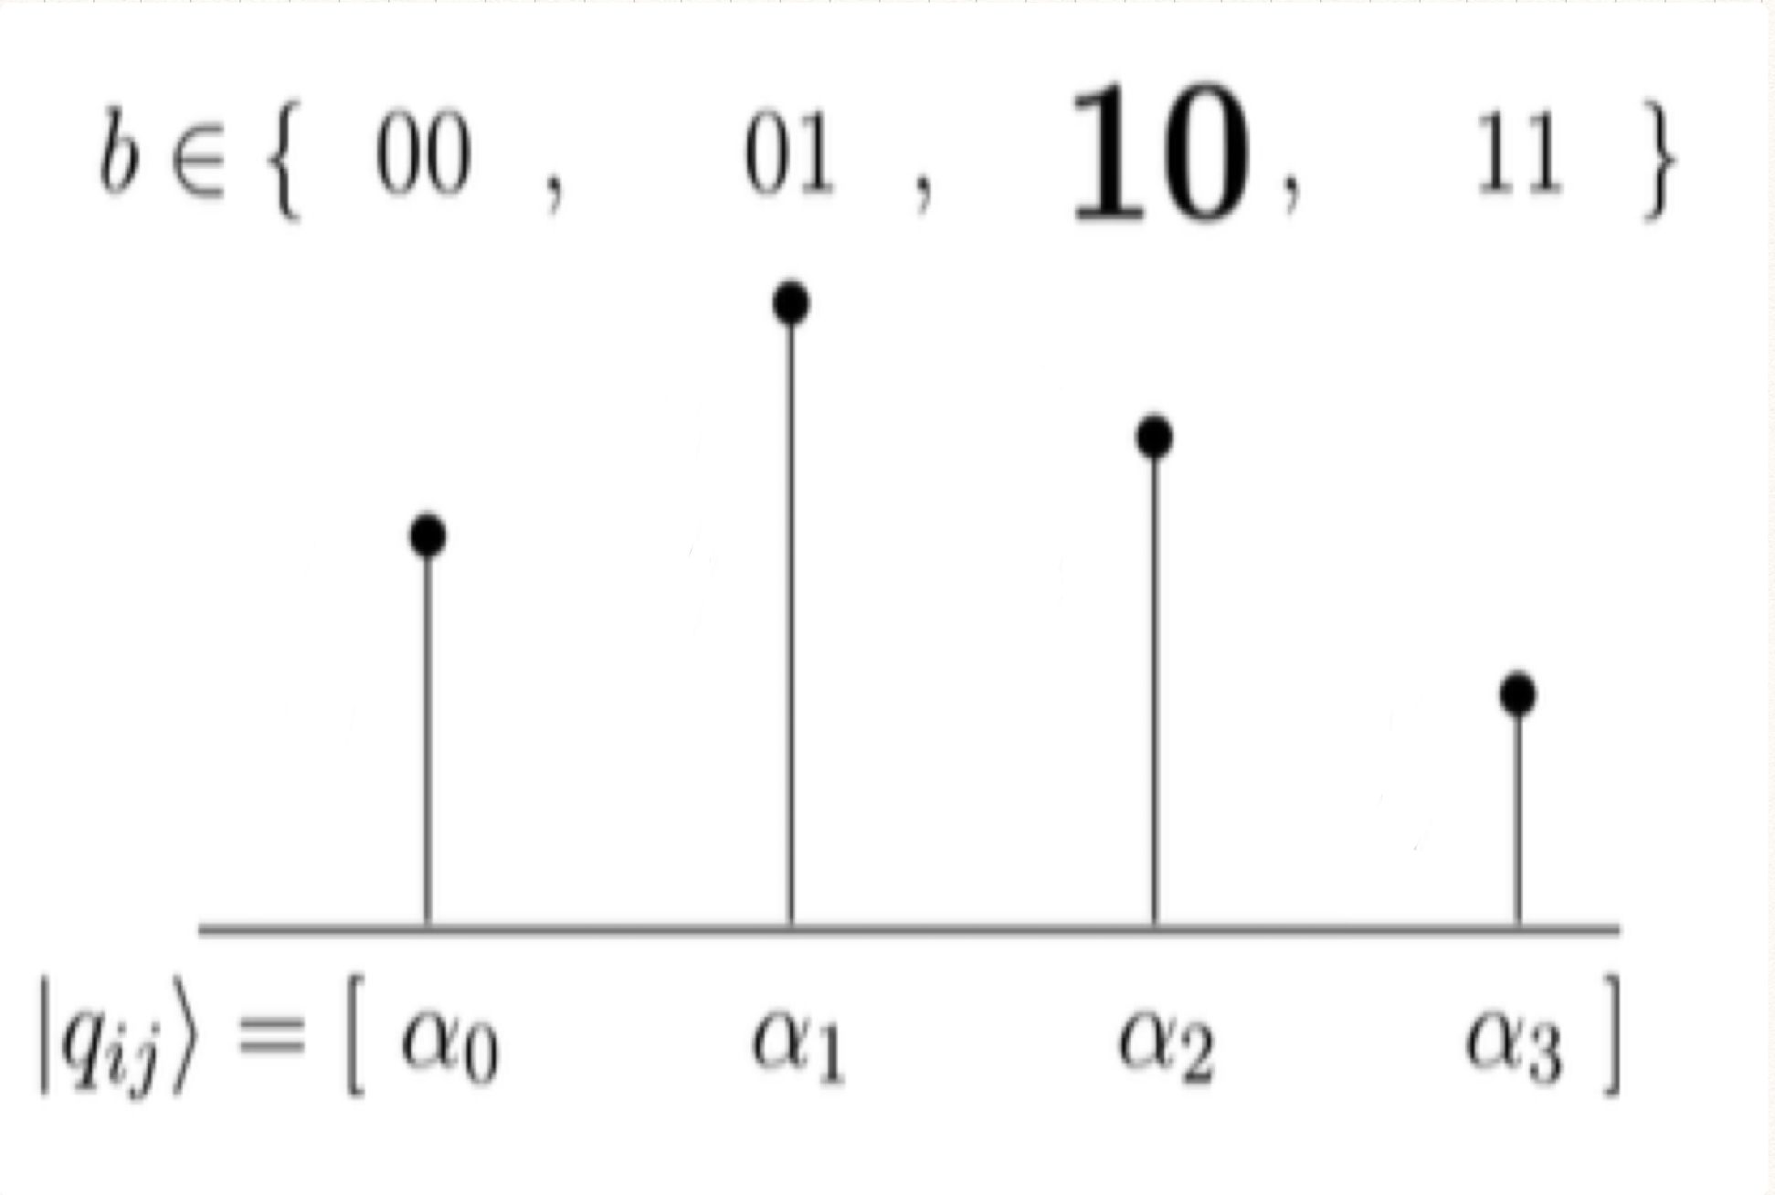
Procedure: Binary Genes
Creating Binary Genes from Quantum Registers

Slide 11
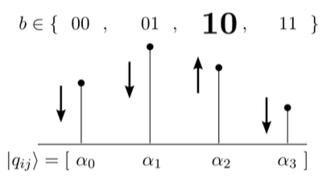
Procedure: Manipulating Amplitudes
Find the Best Individual by Manipulating Probability Amplitudes

Slide 12
Procedure: Find Converging Value
Probability Amplitudes will Converge and the value is returned as the best individual

Slide 13
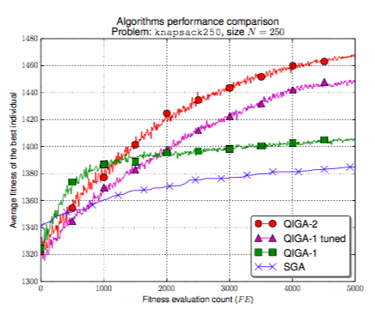
Procedure: Stabilization

Slide 14
Procedure: Disaster Condition
After the graph of probability amplitudes for each best individual stabilizes onto an asymptote, I will employ a disaster condition, such as removing one of the quantum registers passed into the black-box function, and the algorithm will be called another 5000 times.

Slide 15
Sample Testing
Problem | Size (N) | SGA | QIGA - 1 | QIGA - 1 Tuned | QIGA - 2 | My QIGA - 2 Tuned Function
knapsack-100 | 100 | 577.71 | 578.81 | 592.82 | 596.48 | 610.49
knapsack-250 | 250 | 1387.92 | 1406.53 | 1449.91 | 1467.41 | 1510.79
knapsack-400 | 400 | 2209.92 | 2222.16 | 2284.97 | 2334.49 | 2397.3
knapsack-500 | 500 | 2803.27 | 2812.74 | 2869.77 | 2929.47 | 2986.5
knapsack-1000 | 1000 | 5451.66 | 5462.72 | 5568.23 | 5709.12 | 5814.63

Slide 16
Future Work
Knapsack problem to improve communities after wildfire
Take down terrorist communities using the genetic algorithm
Improve efficiency of knapsack problem

Slide 17
References
Black Box. Tv tropes. Retrieved from tvtropes.org/pmwiki/pmwiki.php/Main/BlackBox
Bone, S., Castro M. (n.d.). A Brief History of Quantum Computing . Retrieved from www.doc.ic.ac.uk/~nd/surprise_97/journal/vol4/spb3/
(2017, Aug). Dynamic Programing | Set 10 (0-1 Knapsack Problem). Geeks for Geeks. Retrieved from www.geeksforgeeks.org/knapsack-problem/
Nowotniak, R., Kucharski, J. (2014, Sept). Higher-Order Quantum-Inspired Genetic Algorithms. IEEE. doi: 10.15439/2014F99

Slide 18
References…
(2017, Nov 14). Quantum leap spells new age of computing. The Day. Retrieved from http://theday.co.uk/technology/quantum-leap-spells-new-age-of- computing
Trimok (2013, Dec 24). Particle in a 1-D box and the correspondence principle [Msg 1]. Message posted to physics.stackexchange.com/questions/91221/particle- in-a-1-d-box-and-the-correspondence-principle?answertab=oldest#tab-top
Wang, H., Liu, J., Zhi J., & Fu, C. (2013, Mar 9). The Improvement of Quantum Genetic Algorithm and Its Application on Function Optimization. Hindawi, 2013. http://dx.doi.org/10.1155/2013/730749

Slide 19
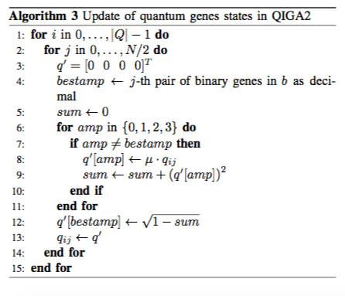
Procedure: Finding Best Individual

Slide 20
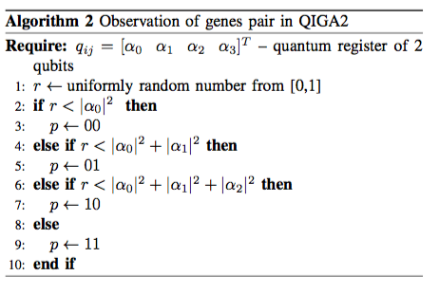
Procedure: Manipulating Amplitudes

